Slide 1
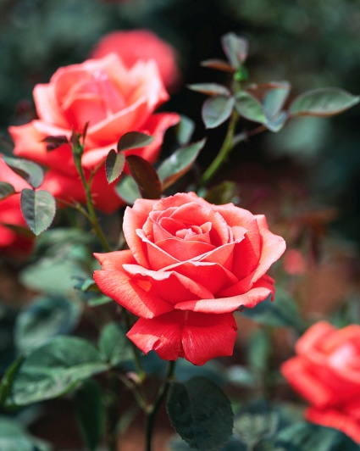


Roses
February 4, 2014
Presented by: Phyllis Jiacalone

Slide 2

Rose - History
1985 – Rose became “National Floral Emblem of the US”
Oct 7, 1986 –Rose became official flower of the US –signed by President Reagan in White House Rose Garden ceremony

Slide 3

What We Will Cover
Grades of Roses
Selection
Planting
Fertilizers
Troubleshooting Rose Problems
Nutritional Deficiencies
Pruning Roses

Slide 4
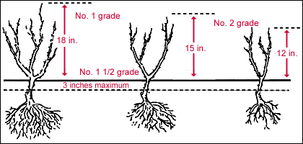
Bare Root Grades
American Nursery Standard Rose Grades
Grade 1: 3 or more canes, abt ¾ “ diameter & no more than 3-4” between graft union & top of roots; large, well developed roots; must be 2 yrs old when harvested from field
Grade 1 1/2: 2 strong canes & w/care will catch up to Grade 1
Grade 2: Bargain –often with small canes, substandard

Slide 5
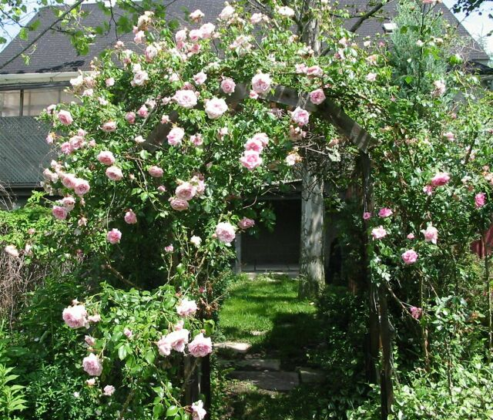
Rose Selection
Select a plant that will fit
the space size wise and if climbing, has support
Select plants that are adapted to your climate (heat resistance in AZ more important than cold tolerance)
Select plants that are resistant to diseases and insects

Slide 6
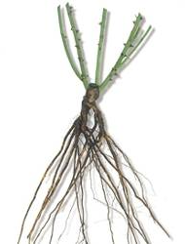
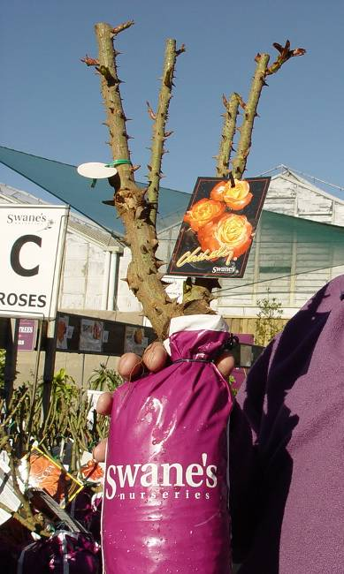
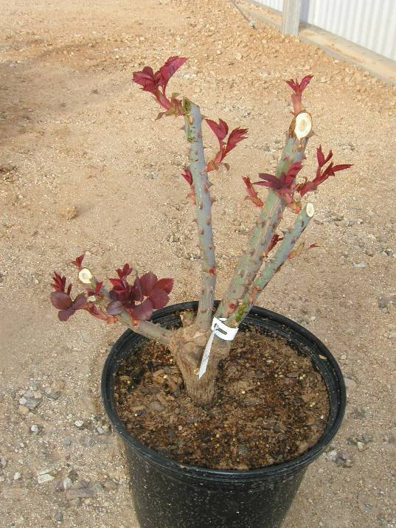
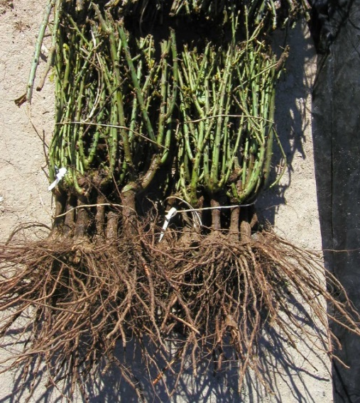
Bare root
Packaged
Containerized

Slide 7
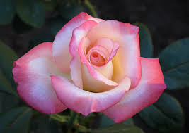
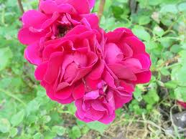
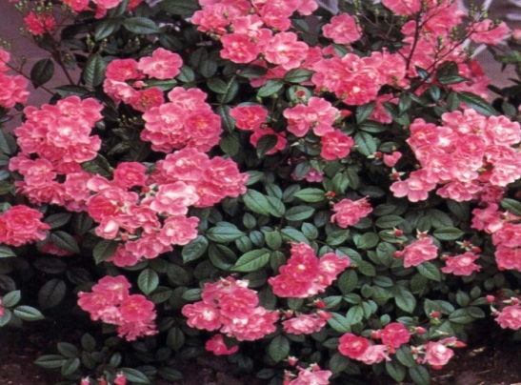
Types of Roses
Hybrid Teas
  Most popular; long stem w/ single flower
Floribundas & polyanthas
  Many blooms per stem, shrub rose
Polyantha
Floribunda

Slide 8
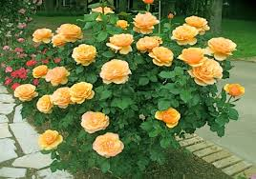
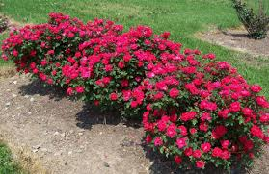
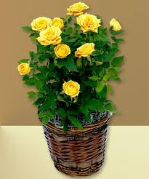
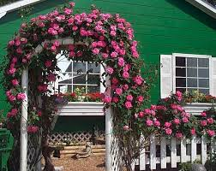
Grandifloras - Cross between hybrid tea and floribunda; masses of large flowers
Shrub Roses
Miniature Roses
Climbing Roses

Slide 9
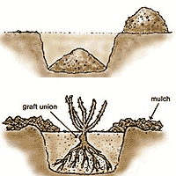
Planting Bare-Root Roses
½ cup triple super phosphate
½ cup sulfur
Soil
Soil = 50% organic matter &
50% native soil (e.g. clay)

Slide 10
Digging the Hole
Dig holes at least 3 ft apart in location with at least 6 hrs of sunlight/day
Dig hole at least 18” to 24” deep and as wide
Put soil and amendments in the hole in the shape of a cone

Slide 11
Planting Bare-root
Soak entire bush in water – 8 to 24 hrs prior to planting
Trim canes back to 8 to 10 inches to outward facing bud eye
Cut off damaged roots
Spread roots over cone when planting
Keep bud union just above soil level
Cover roots with compost/soil mixture
Water slowly and deeply to remove air pockets & to keep roots from drying out
Firm up soil around bush, but don’t compact it
Can top-dress with mulch

Slide 12

Planting Container-grown
Same size hole as bare-root
No need for cone, but can
  still add triple super phosphate and sulfur
Carefully remove from container, try not to disturb root ball
Carefully straighten coiled roots

Slide 13
When to Plant & Prune – Yavapai County
Prescott, Prescott Valley, Chino Valley
  Plant bare root – February / March
  Plant container grown – Start in February
  Prune – Start March
Sedona, Cottonwood, Verde Valley
  Plant bare root – February / March
  Plant container grown – Start in January
  Prune – Start February

Slide 14

Fertilizers
Ideal pH for roses is 6.0 to 6.5 –
  6.5 to 7.0 OK for Yavapai County
Fertilize newly planted roses AFTER first bloom
Epsom salt for plant tissue and roots; helps stimulates cane growth
Systemic fertilizer OK if don’t need show roses
Roses love nitrogen (e.g. fish emulsion)
Organic or chemical fertilizers OK (organic need warm soil and work more slowly than chemical)

Slide 15

Fertilizing Established Roses
March – after pruning
  Triple Super Phosphate for blooms
  Organic material (e.g. bone meal, compost)
  Non-organic (systemic rose food)
Mid-April through September
  ½ cup Epsom salt in mid-April & twice again this year
  Systemic rose food (follow directions – some every 6 weeks)
  Fish emulsion monthly
Don’t fertilize after September

Slide 16
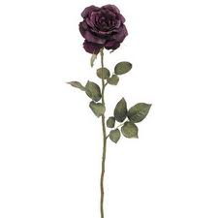
Enjoying Cut Roses
New plants
Cut ¼ above outward facing five-leaflet; leave as many
leaves as possible on
the plant
Established plants
  Leave 2 five-leaflet leaves on shoot

Slide 17
Cut Flower Preservative
2 Tbsp fresh lemon juice
1 Tbsp sugar
½ tsp bleach
1 quart warm water
Deters bacteria & mold growth, provides sucrose to feed flowers, & acidifies water to help stems take up more water

Slide 18
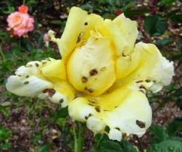
Problems
Aphids
Thrips
Cane Borers
Spider Mites
Leaf Cutter Bees
Powdery Mildew
Crown Gall
Rose Mosaic Virus
Nutrient Deficiencies

Slide 19
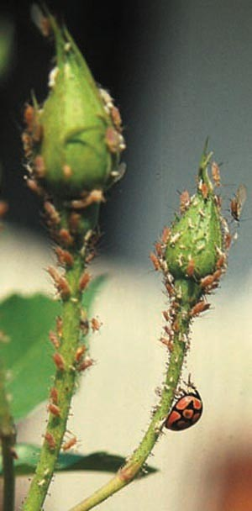
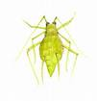
Aphids
Aphid colors could be green, yellow, brown, red, or black
Potential damage: curled, yellow, & distorted leaves, stunted shoots, honeydew which turns black w/ growth of sooty mold fungus. Ants are attracted to honeydew.

Slide 20
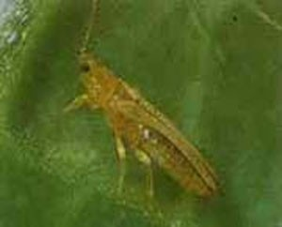
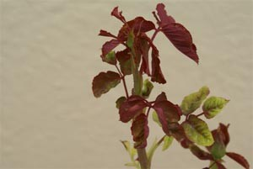
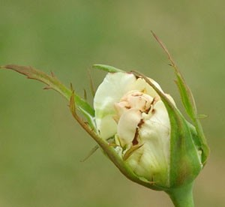
Thrips
Damage

Slide 21

Aphid and Thrips Controls
Monitor for beneficials (lady bugs, lacewings, etc.)
Destroy infected buds & blooms
High pressure hose
Home remedy (1 TBSP dish washing liquid or baby shampoo, 2 drops vegetable oil, 1 gallon water)
Yellow sticky tape (thrips)
Insecticidal soap
Neem

Slide 22
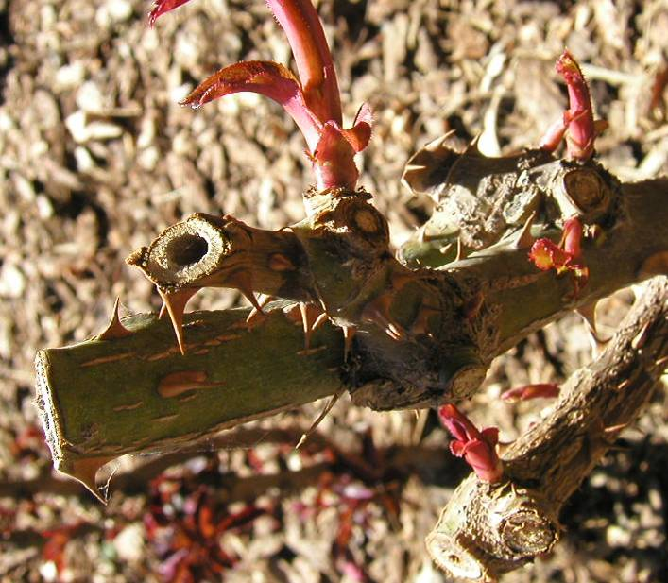
Cane Borers
Tunnels into canes soon after winter pruning
If hole present, cut back until cane is healthy
Use wood glue to seal wound if desired

Slide 23
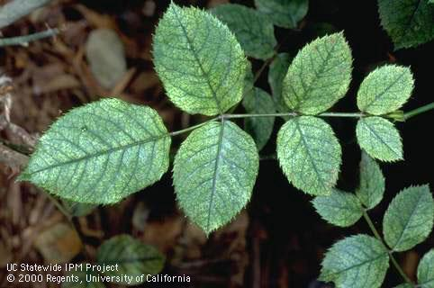
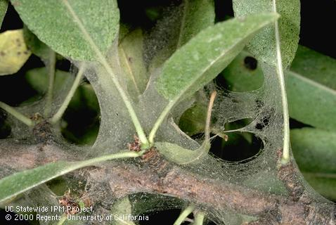
Spider Mites
Small, on leaves
Sometimes webbing
Hot, dry weather
Often increase in numbers if a broad spectrum pesticide killed beneficials
Damage to buds cosmetic
Control with strong stream of (soapy) water

Slide 24
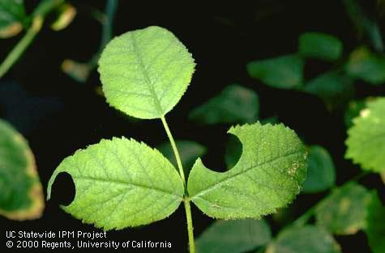
Leaf Cutter Bees
Circular leaf cuts
Damage only cosmetic

Slide 25
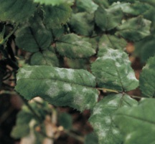
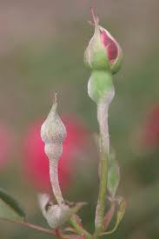
Powdery Mildew
Cool damp nights, warm days,
spread by wind; poor air circulation
Mostly on leaves as small blisters
followed by white or gray powdery spots
Manage with good gardening practices, cleanup old leaves & pruned material, hard spray of water; spray with fungicide when first noticed
Preventative: 1 Tbsp baking soda, ½ tsp liquid soap, 1 tsp horticulture oil, 1 gal water

Slide 26
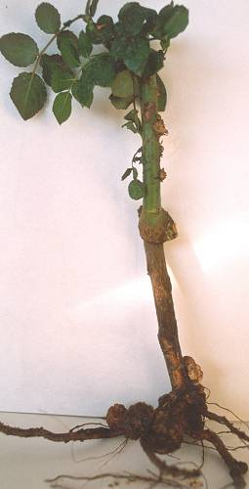
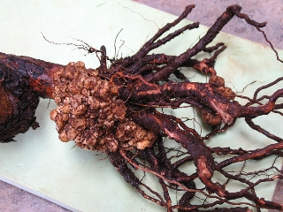
Crown Gall
Caused by Agrobacterium tumefaciens
Infects through wounds
Plant gradually declines as gall
  develops at base of plant
Remove and destroy infected plants
Don’t replant roses in this soil

Slide 27
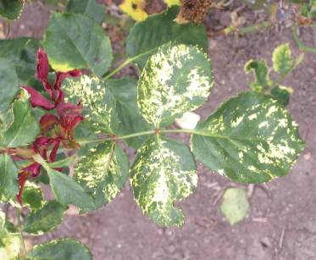
Mosaic Virus
Spreads only through
  infected stock
Not transmitted
  through pruners or shovels
Weakens plant over many years
No cure

Slide 28
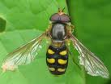
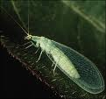

Beneficial Insects
Hoverfly
Lacewing
Larva eats aphids

Slide 29
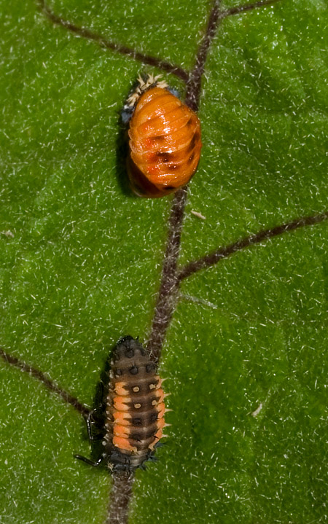
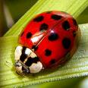
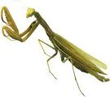

Ladybug Stages
Mantid
Egg casing

Slide 30
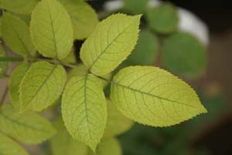
Iron / Nitrogen Deficiency
Iron Deficiency – affects newer leaves – apply chelated iron
Nitrogen Deficiency – affects oldest leaves – apply nitrogen
Chlorosis

Slide 31
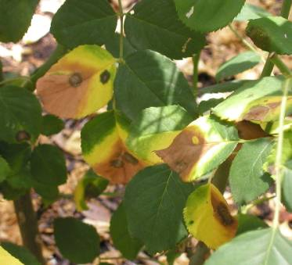
Magnesium Deficiency
Edges of old leaves turn yellow, apply magnesium sulfate (epsom salt) to rose bushes

Slide 32
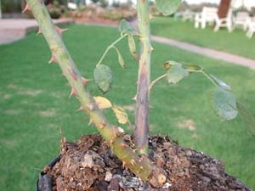
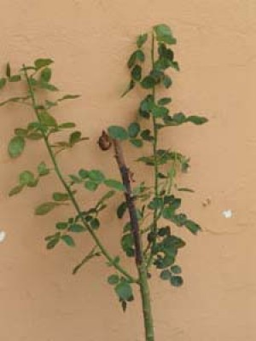
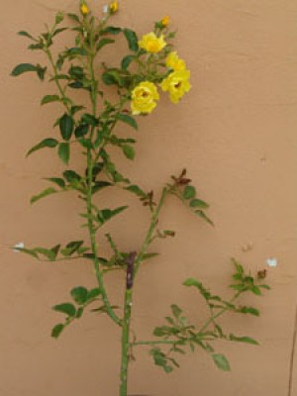
Similar Cane Symptoms
Sunburn
Stem Canker
Normal frost dieback

Slide 33
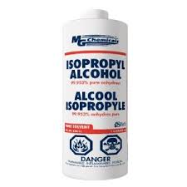
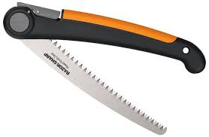
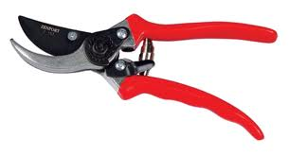
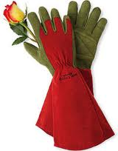
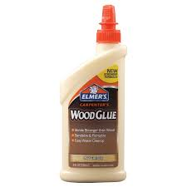
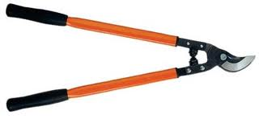
Pruning

Slide 34
Why Prune
Winter pruning (when dormant) - to stimulate new growth
Dead-heading (through growing season)– to stimulate more flowers

Slide 35
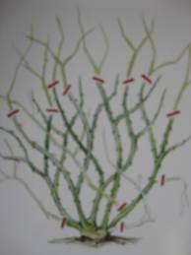
Late Winter Pruning
Remove:
crossing branches
dead canes
diseased canes
suckers below graft union
stems less than pencil size
all leaves

Slide 36
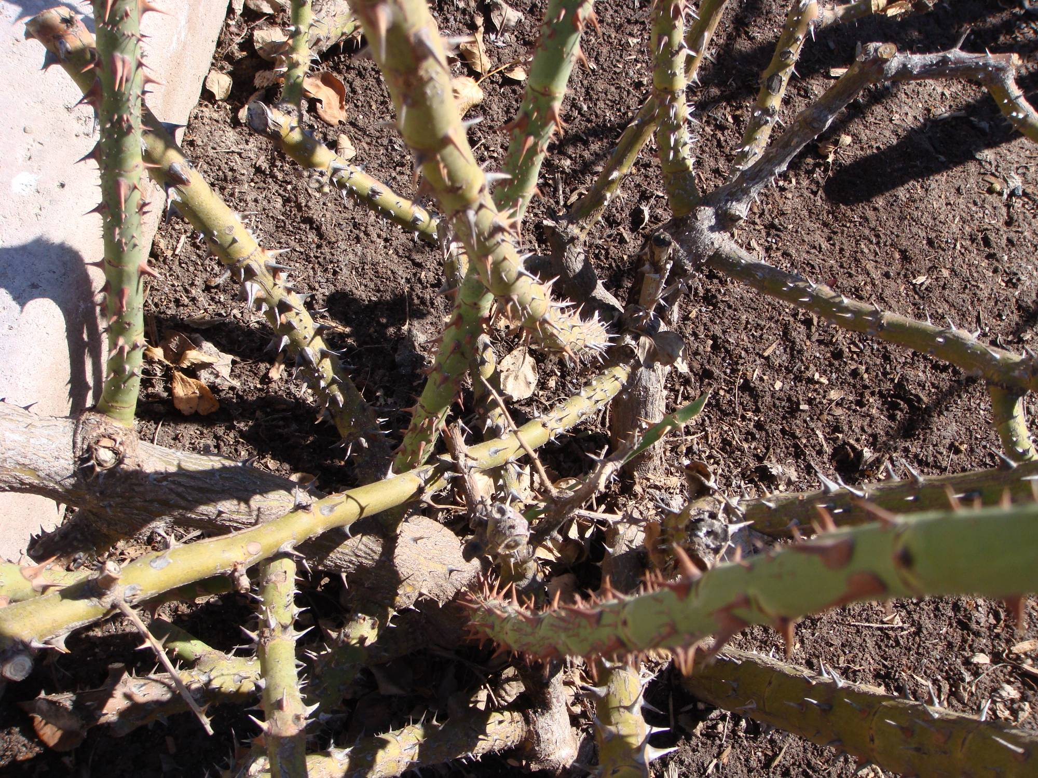
Crossing

Slide 37
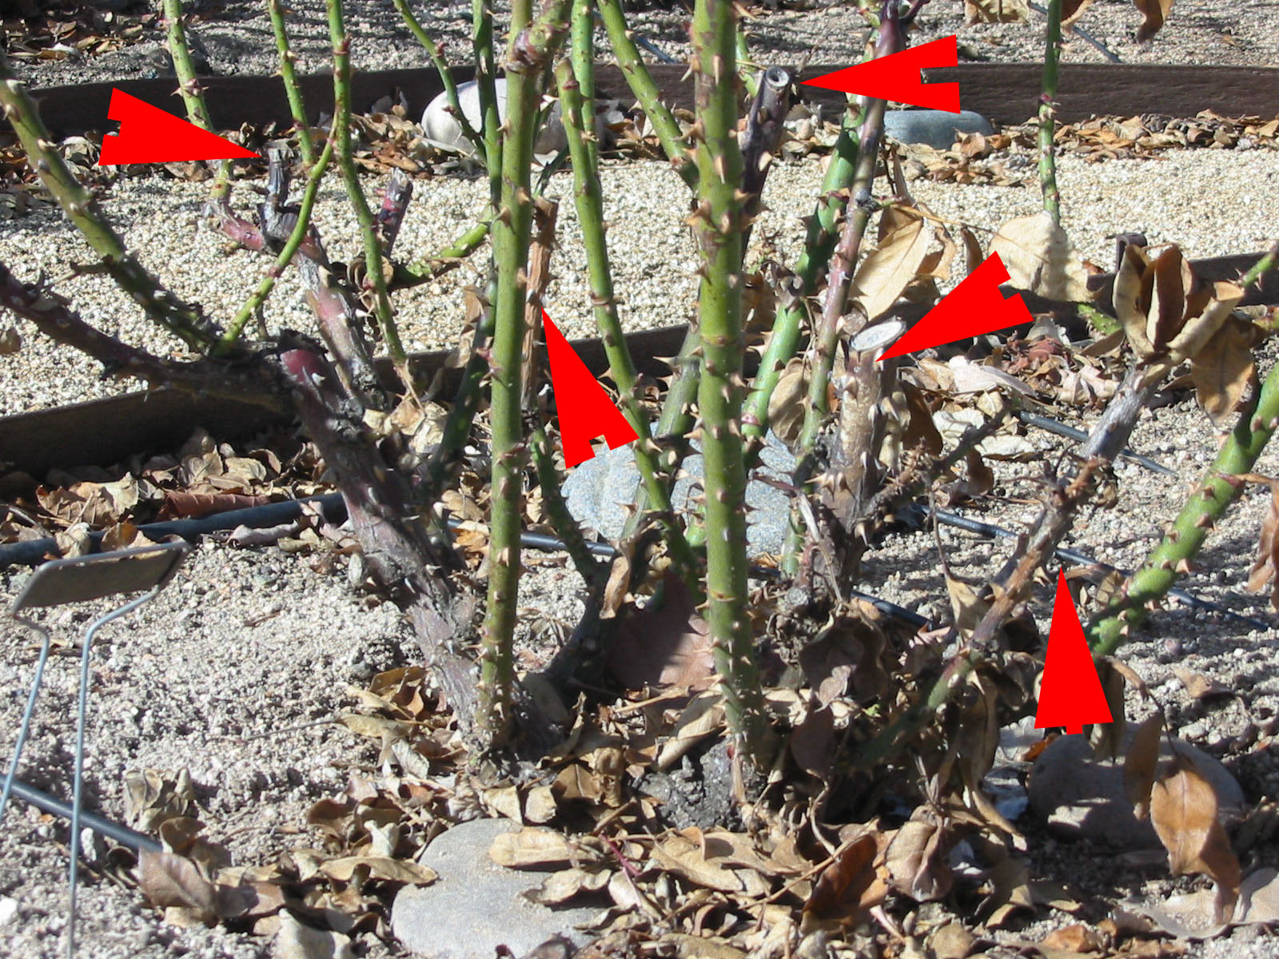
Dead & diseased canes

Slide 38



Cut canes above a bud, slanting away from bud

Slide 39


To generate new growth on old wood -
Use wire brush to scrub old gray crusty wood
Put 1 cup epsom salt on soil and water in

Slide 40


Hybrid Teas
Leave 5 to 8 canes on vigorous bushes; can leave up to 12 canes if good spread
Amount to prune varies w/ available space as plants grow older; general rule – cut back new cane growth about 1/3

Slide 41

Pruned Hybrid Tea

Slide 42

Grandiflora
4-8 ft tall
Leave 3-5 canes
Cut height back by 1/3 to 1/2

Slide 43

Floribunda
Often need thinning in center
Can leave more canes than Hydrid Tea and Grandiflora
Take less than 1/3 off the top

Slide 44

Pruned Floribunda

Slide 45

Carpet Roses
Shear off or cut back so that it is about a foot tall or cut off the top two-thirds of the plant (can use hedge shears or a hedge trimmer)

Slide 46

Climbers
  Leave major canes to support desired shape
  Cut side branches off major canes to encourage more new growth (flowers)
  Remove all leaves
  Cut crossing, dead canes from base

Slide 47
Safety
Wear sunblock to protect from UV rays
Get tetanus shot every 10 yrs – working with soil
Wear long sleeves, gloves, eye protection
If spraying chemicals, wear mask and wash clothing separate from other laundry
Wear closed shoes – no open toes when gardening
Never spray chemicals if wind is blowing
Best to spray in early morning (cool and air is still) – don’t spray if over 80°
Try to use organic sprays to protect the good bugs
Be environmentally friendly!!!!

Slide 48
More than a symbol of love -
Color is definitely a personal preference. While the red rose may be the first to come to mind, a rainbow of colors exist. The chart on the next slide matches some of the most popular colors with sentiments they express.

Slide 49
Color | Sentiment
Red | Love, respect
Deep pink | Gratitude, appreciation
Light pink | Admiration, sympathy
White | Reverence, humility
Yellow | Joy, gladness
Orange | Enthusiasm, desire
Red and yellow blend | Gaiety, joviality
Pale blended tones | Sociability, friendship

Slide 50
Resources
American Rose Society
    http://www.ars.org/
    Rose diseases & pests
    http://sactorose.org/rosebug/
Created by Yavapai County Master Gardeners: Phyllis Jiacalone & Mary Barnes

Slide 51
Questions
??????

