Slide 1
Plant Propagation
Jeff Schalau
Assoc. Agent, Agriculture & Natural Resources
University of Arizona, Cooperative Extension, Yavapai County

Slide 2
What is Plant Propagation?
Increase numbers of a species
Perpetuate a species
Maintain youthfulness of plant

Slide 3
Two Kinds of Propagation (Reproduction)
Sexual
Pollen and egg combine genetic material to create a new, uniquely individual plant
Asexual
Cloning a new individual from a part of a single parent plant

Slide 4
Two Types of Cell Division
Mitosis
One mother cell divides to form two daughter cells that are genetically identical to the mother cell
This is normal plant growth
Meiosis
One mother cell divides to form gametes (reproductive cells, egg, pollen)
No gamete formed is genetically identical to the gametes that combined to form the parent plant

Slide 5
Sexual Reproduction
Meiosis occurs in mother cells in flowers
Chromosome number is cut in half
Random shuffling of genetic material (DNA) occurs
Pollen (male)
Egg (female)
Fertilization occurs
Pollen grain lands on stigma and germinates, and deposits its chromosomes, in the egg, a seed is formed

Slide 6
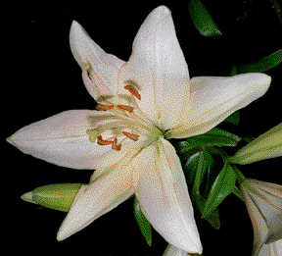
Lilly Flower

Slide 7
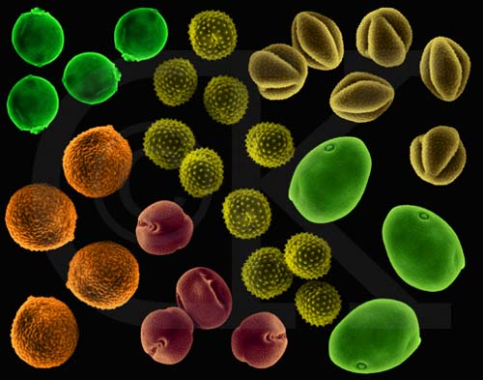
Pollen Grains

Slide 8
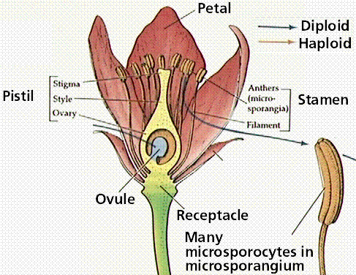
Fertilization I

Slide 9
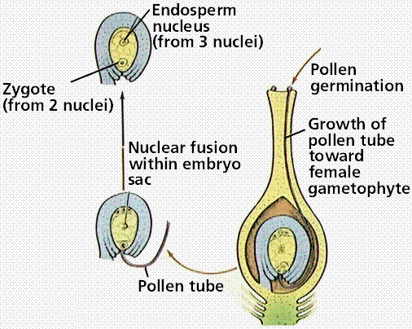
Fertilization II

Slide 10
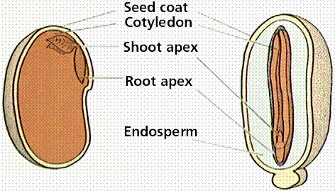
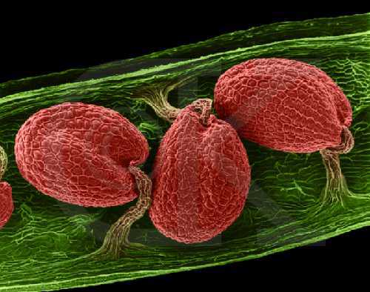
Seed Morphology
Seed Coat
Endosperm
Embryo

Slide 11
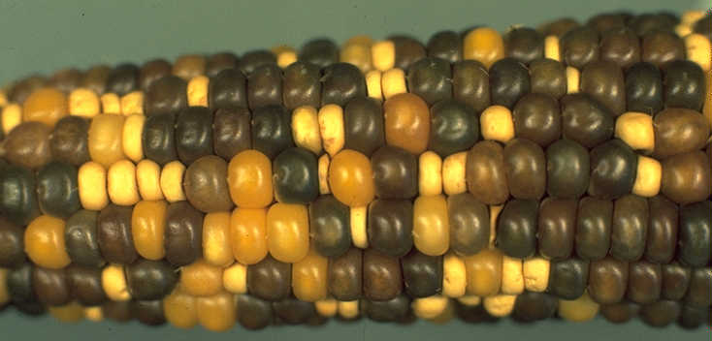
Creating Hybrids
Remove anthers from the flower of the female parent prior to pollen maturation to prevent self-pollination.
Collect pollen from the male parent.
Transfer the pollen to the stigma of the female parent using a fine brush.
Tag the flower, indicating the date and the cross made (female x male).
Harvest the mature seed.
Plant the seed.

Slide 12
Propagation from Seed
Use high quality seed
Use seed that is adapted to your local conditions
Check seed purity (weeds, chaff, etc)
Store in a cool (40oF) dry place
Seed Saving-know what you are doing

Slide 13
Factors that affect seed germination
Water
Oxygen
Light
Temperature
Dormancy

Slide 14
Germination - Water
Seed coat may inhibit imbibition (absorption) of water
Adequate supply of water is crucial after seed coat has been overcome
Too little water and the embryo will not grow properly
Too much water can encourage disease

Slide 15
Germination - Light
Some seeds have a light requirement that must be met
Others will not germinate if light is present
Seed packets should provide instructions

Slide 16
Germination - Oxygen
All live seeds are respiring
Dormant seeds have a lower requirement
Once a seed starts to germinate, aeration is critical

Slide 17
Germination - Temperature
Some seeds are sensitive to germination temperature
It is usually heat that increases germination (i.e. tomatoes, beans)
Bottom heat is used in some greenhouse situations
In the environment, soil temperature is critical for proper germination

Slide 18
Seed Dormancy
Innate ability of a seed to germinate when conditions are optimum for survival
Types
Physical (seed coat)
Physiological/Chemical
None

Slide 19
Seed Dormancy - Physical
Seed coat – air/water cannot get in even if temperature is correct
Can be broken by
Sandpaper
File
Going through an animal’s gut
Soil microorganisms
Fire

Slide 20
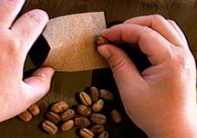
Seed Dormancy - Physical

Slide 21
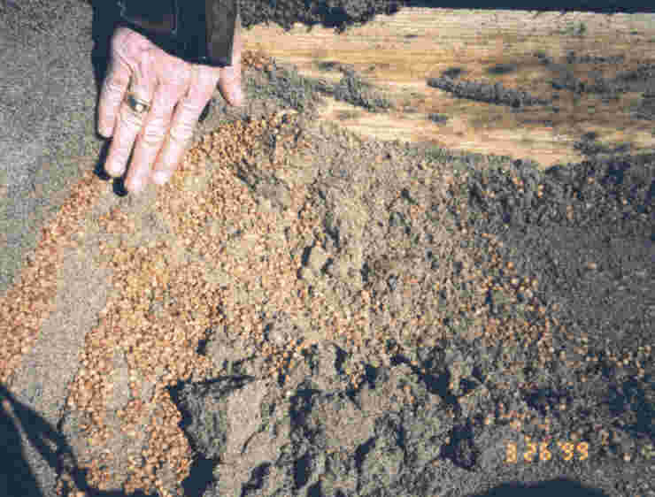
Seed Dormancy – Physiological/Chemical
Hormones present in the seed prevent ripening or development of the embryo
Stratification
Vermiculite
Sand
Paper towel

Slide 22
Starting Seeds - Media
Free of disease, weeds, and insects
Homemade mix
1/3 sterile soil
1/3 sand, vermiculite, or perlite
1/3 peat moss
Commercial potting soil
Do not use untreated soil

Slide 23
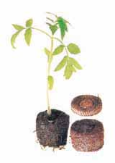
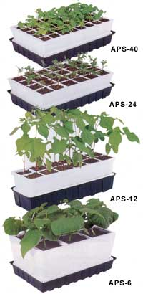
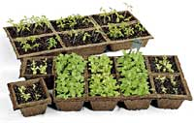
Starting Seeds - Containers
Buy commercial flats and containers from gardening supply companies

Slide 24
Starting Seeds - Containers
Wood seed trays can be built
Used commercial flats and pony packs should be sterilized in a 10% bleach solution
Milk cartons, pie pans, etc can also be used if sterilized and holes are punched

Slide 25
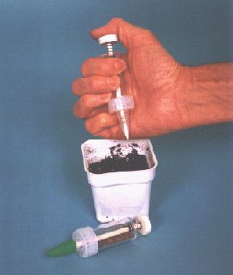
Seeding
Start seeds at proper time
Plant at the proper depth
Legumes should be inoculated
Cover seed with appropriate material: perlite, vermiculite, sand
Pre-germination is a good way to start tomatoes, peppers, and other plants that need an early start

Slide 26
Transplanting Seedlings
Don’t leave seedlings in flat or container too long
Allow a “hardening off” period
Be gentle with the root systems
Give them adequate space
Water and fertilize after transplanting

Slide 27
Asexual Propagation
Cuttings
Layering
Division
Grafting
Budding
Tissue Culture

Slide 28
Cuttings
Stem – most common
Tropicals – anytime
Hardwood – fall or dormant season best
Others – tip, cane, eye, heel, leaf, root
Media – appropriate for plant
Necessary: moist environment, well aerated, and minimal disease
Success may be increased with rooting hormones/auxins and bottom heat

Slide 29
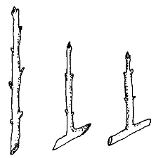
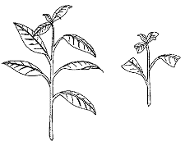
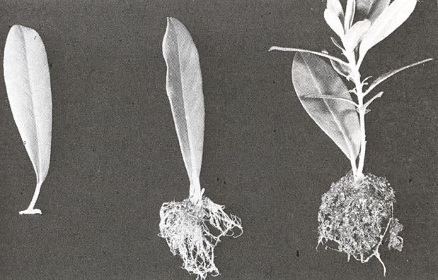
Cuttings

Slide 30
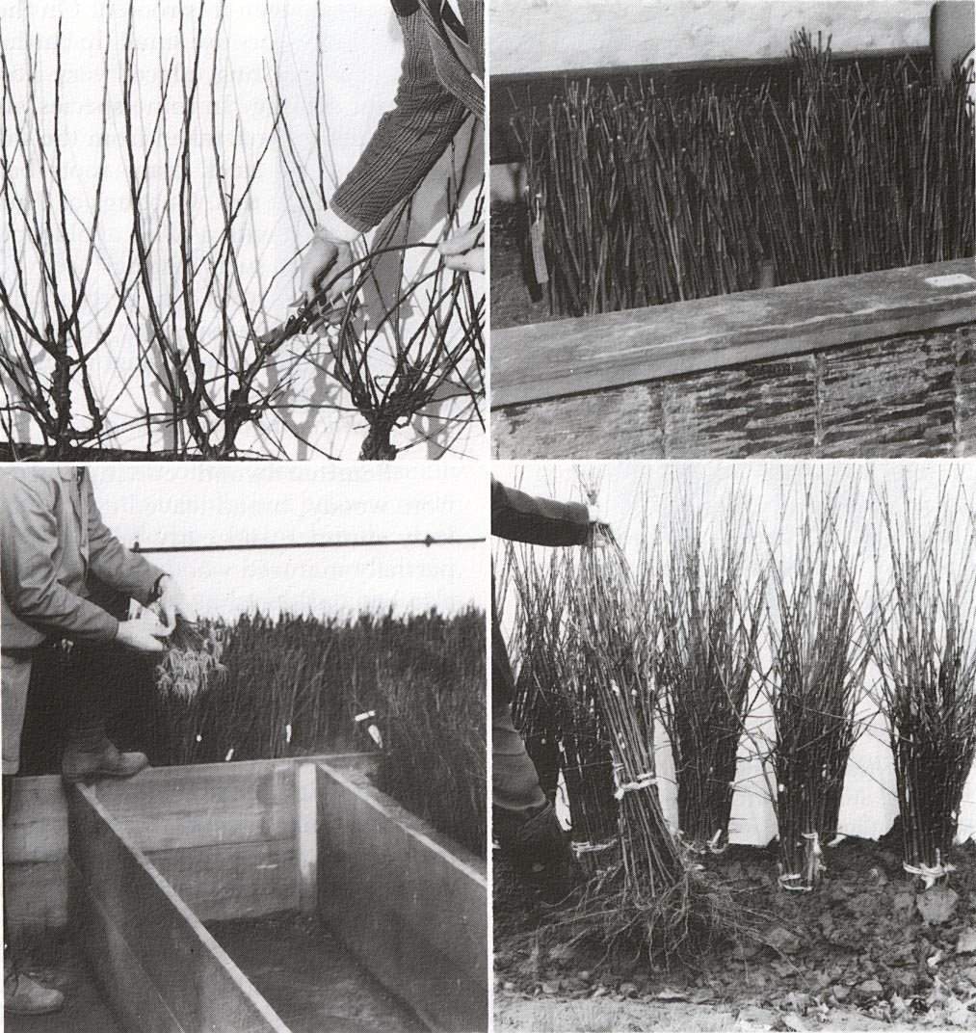
Production Cuttings

Slide 31
Layering
Tip, simple, compound, mound, air
Stem is attached to parent plant while in contact with rooting medium

Slide 32
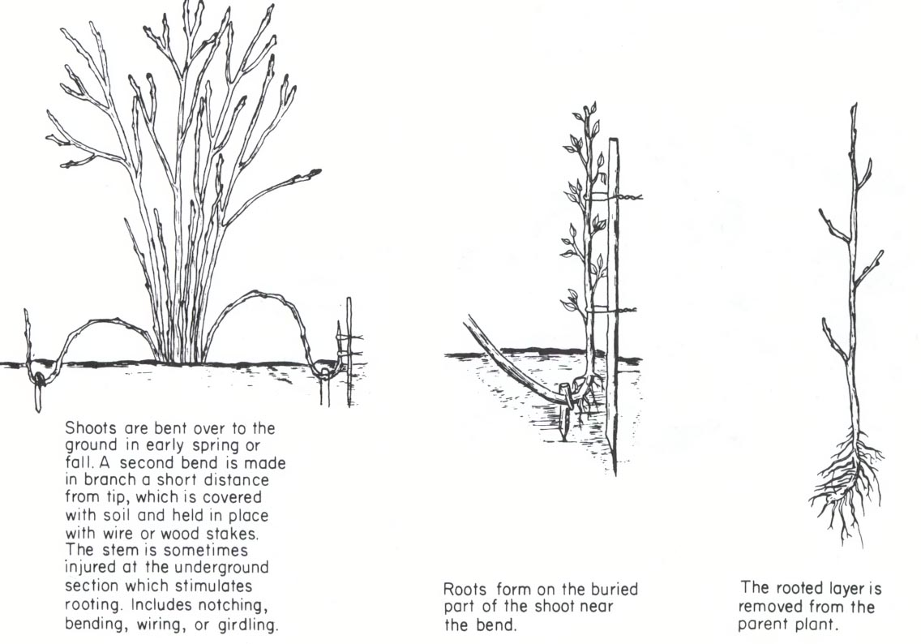
Layering

Slide 33
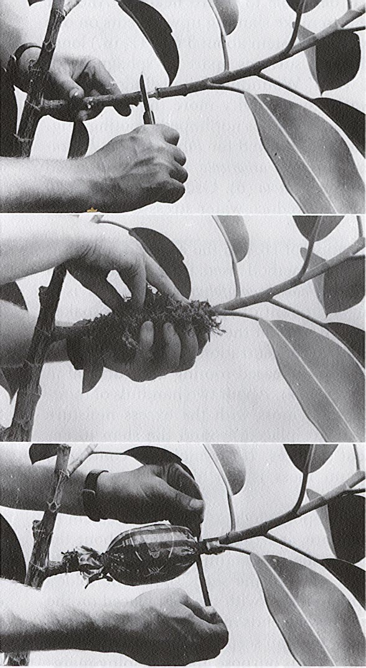
Air Layering
Girdle stem
Wrap with sphagnum peat
Wrap with plastic bag
Wrap with foil to exclude light

Slide 34
Separation/Division
Bulbs, Corms, grasses, ferns, palms, bamboo, and others
Very easy to do

Slide 35
Grafting
Cleft Grafting
Make sure wood is correctly polarized
Scion 3/8 to 5/8 inch diameter
Use a sharp wedge to split rootstock
Align cambium layers of scion and rootstock
Cover with grafting wax
Whip Graft
Use similar diameters and wrap with string and wax

Slide 36
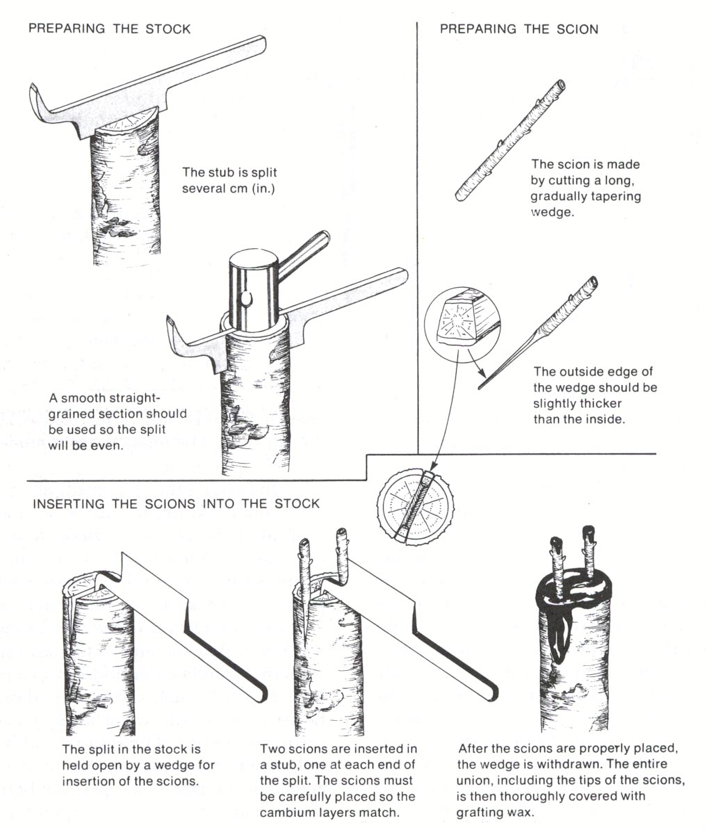
Cleft Graft

Slide 37
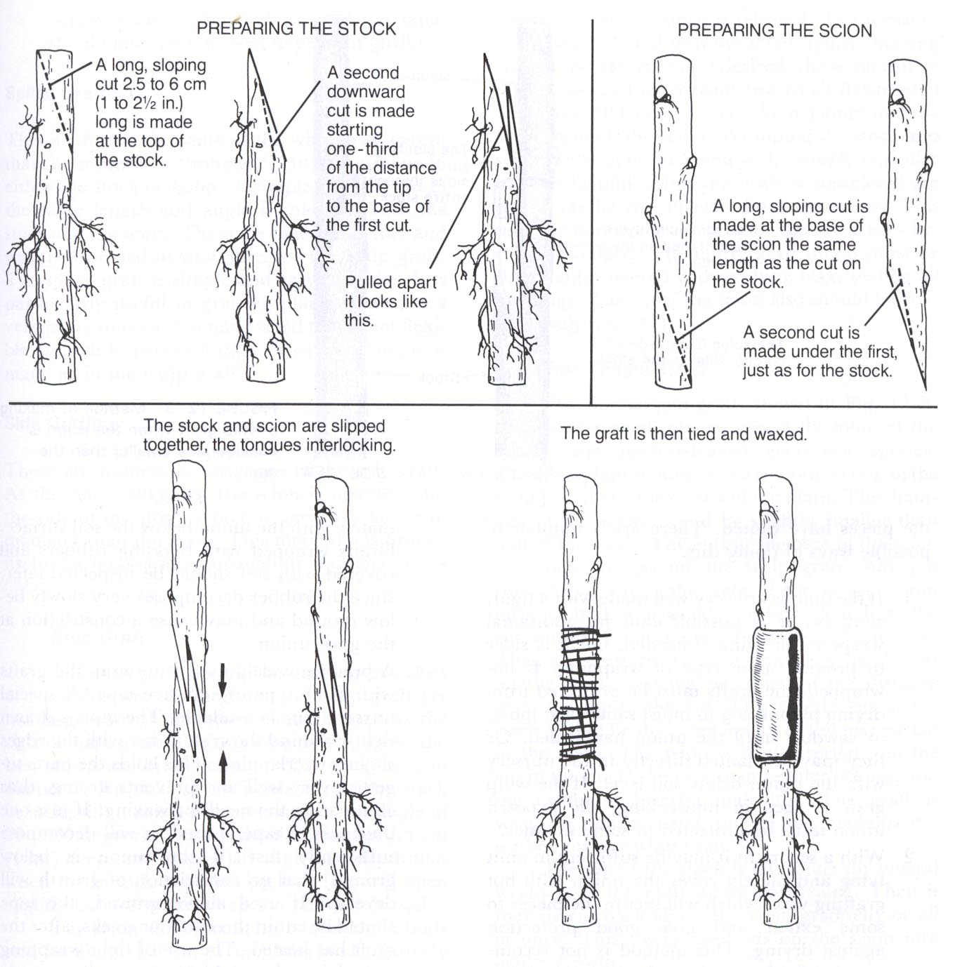
Whip Graft

Slide 38
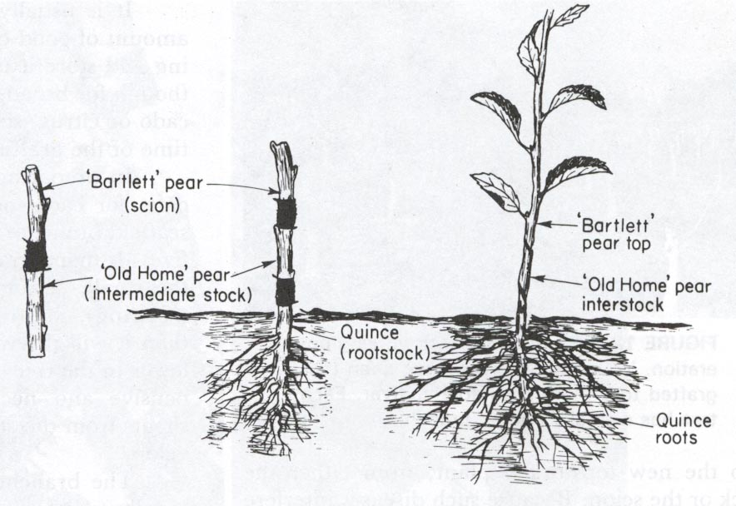
Interstock Grafting
Scion
Interstock
Rootstock

Slide 39
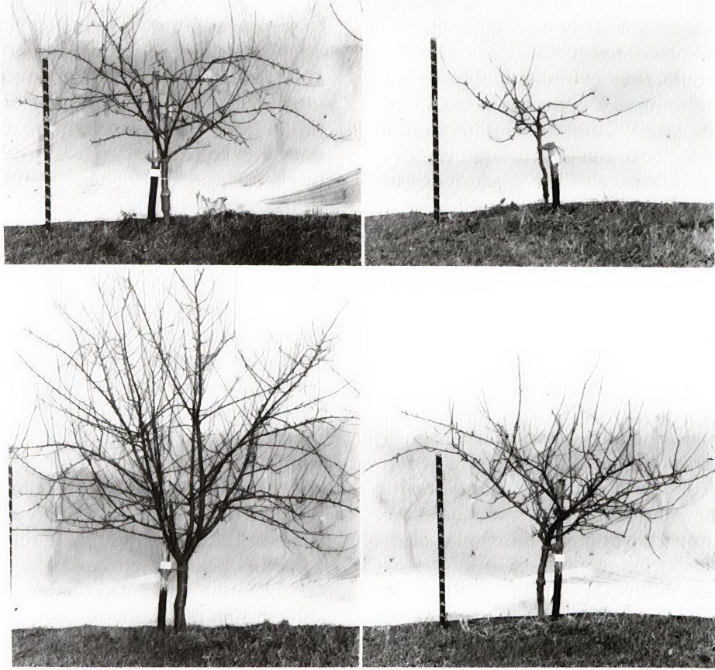
Interstock Grafting Scion=Pippin Apple
M.27
MM.104
M.9
MM.104
M.20
MM.104
MM.104
MM.104

Slide 40
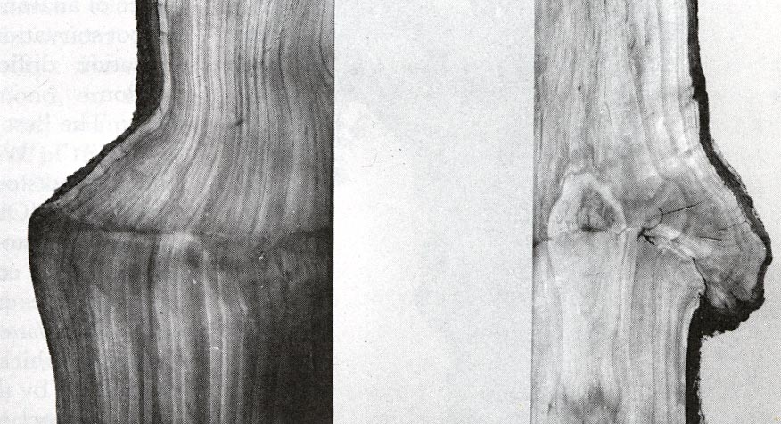
Graft Unions
Compatible
Incompatible

Slide 41
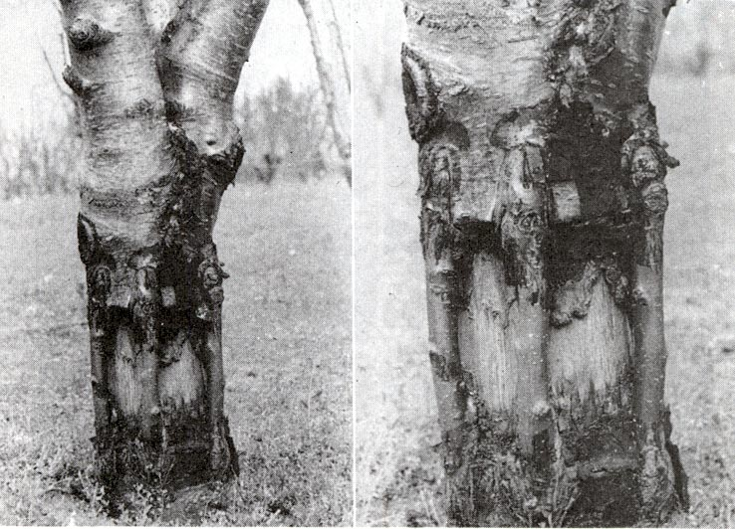
Bridge Graft

Slide 42
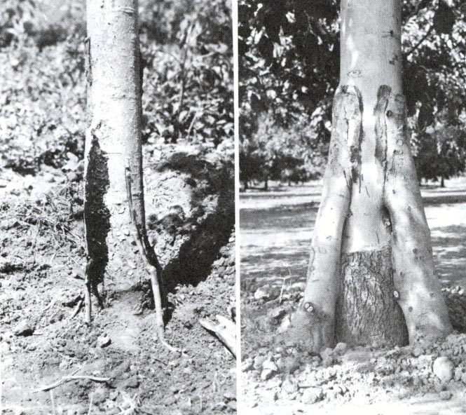
Inarch Graft
Seedlings are planted next to a valuable tree and grafted to replace weak rootstock or invigorate the tree

Slide 43
Budding
Woody plants
Using a bud and a small piece of bark from scion
Especially useful when scion wood is limited
Stronger union that grafting

Slide 44
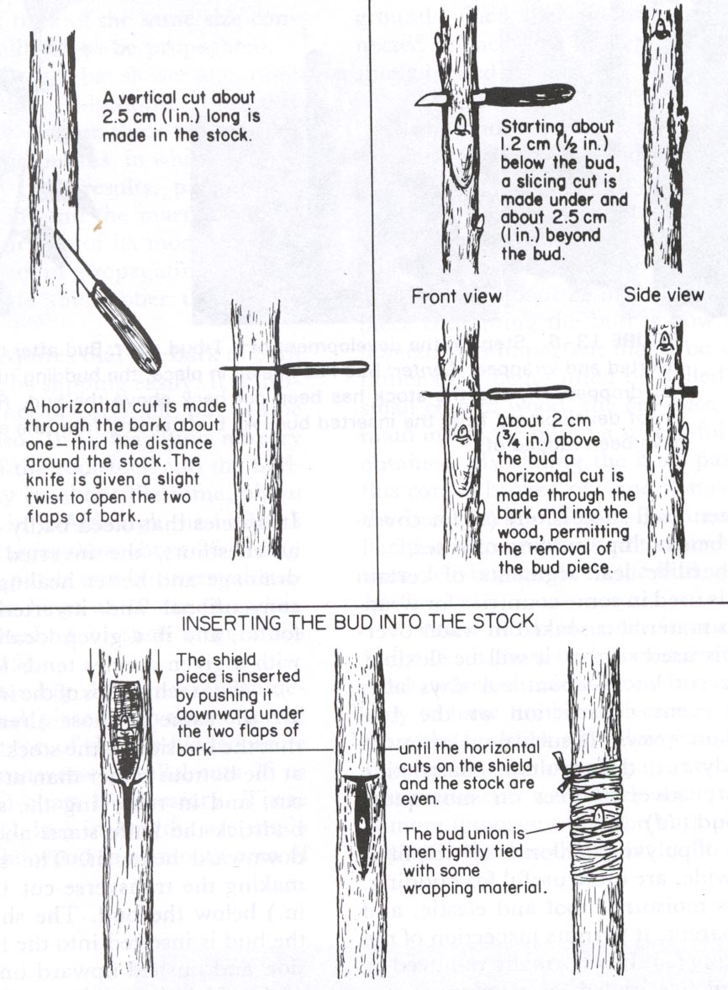
T Budding
Bark must be “slipping”

Slide 45
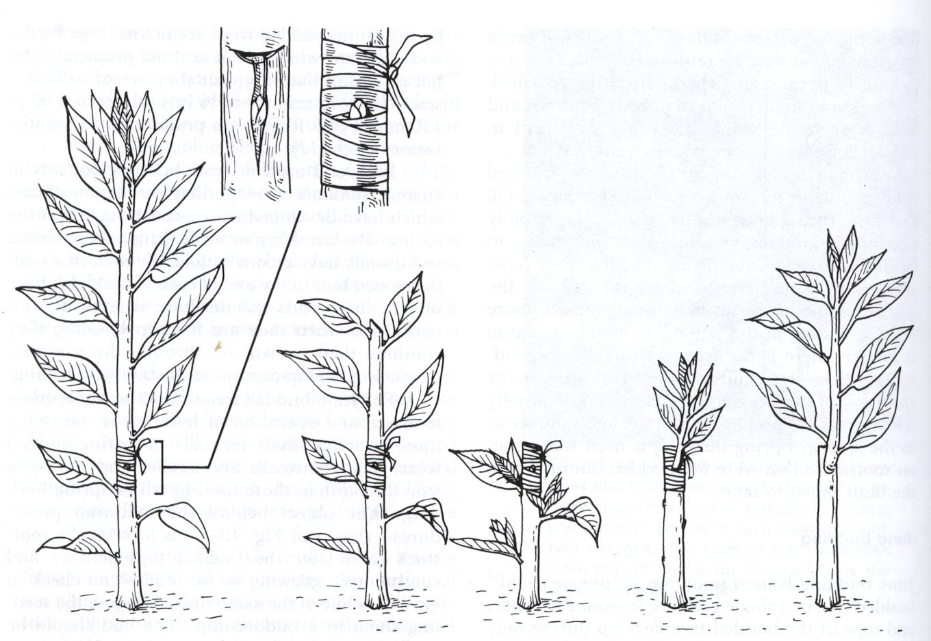
T Budding

Slide 46
Tissue Culture /Micropropagation
Select desirable plant
Sterilize tissue
Plant in sterile media/manipulate to root and induce juvenile state
Grow in sterile culture and propagate
Transfer to nursery containers

Slide 47
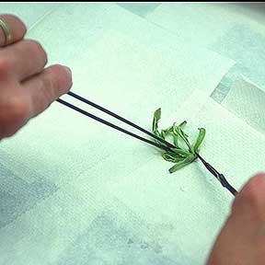
Tissue Culture - Sterilize

Slide 48
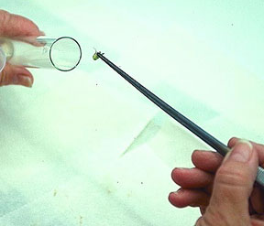
Tissue Culture – Plant in Media

Slide 49
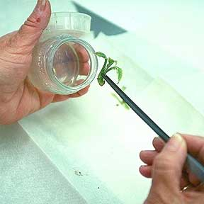
Tissue Culture – Transfer to Jar

Slide 50
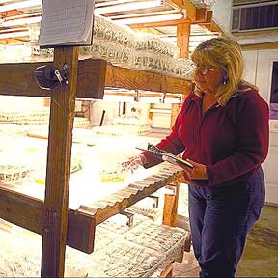
Tissue Culture – Grow Under Lights

Slide 51
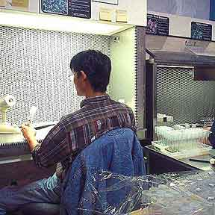
Tissue Culture – Sterile Work Area/Laminar Hood

Slide 52
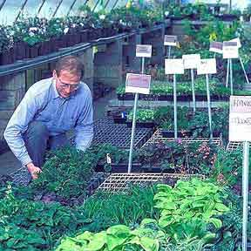
Tissue Culture – Outplant to Nursery

Slide 53
Summary
Knowing your goals and an understanding of plant reproduction is critical to plant propagation success
Try some new things…and
Have fun with it!

