Slide 1

Home Orchard Care
Jeff Schalau
Associate Agent, ANR
University of Arizona Cooperative Extension, Yavapai County

Slide 2
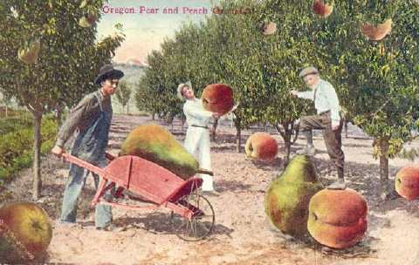
This Can Be You!

Slide 3
Growing Quality Fruit
Requires planning and long-term commitment
Annual cultural practices
  Pruning, fertilization, irrigation, weed control, IPM, thinning, harvesting
Different fruits have different cultural requirements

Slide 4
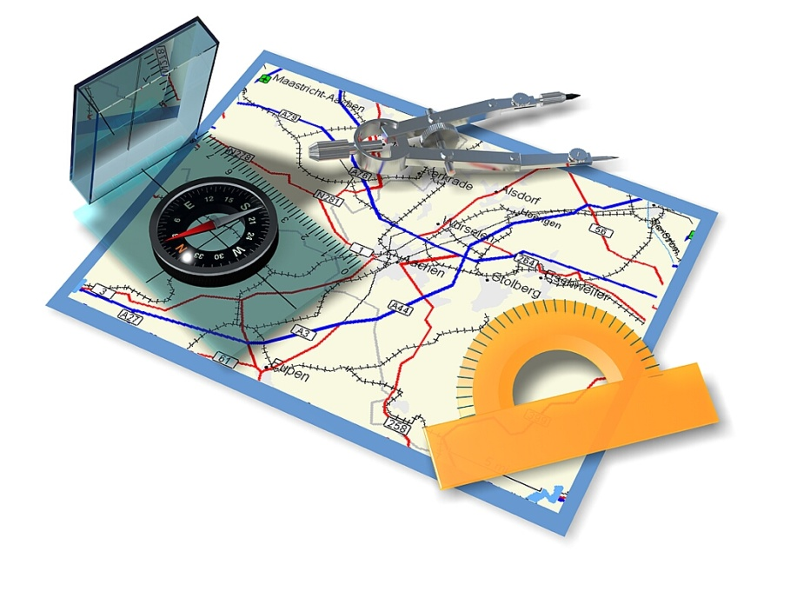
Home Orchard Road Map
Site Selection
Fruit Tree Propagation
Tree Selection and Spacing
Planting
Irrigation
Pruning
Fertilization
Thinning
Harvest

Slide 5
Site Selection
Deep, well-drained, productive soils
Cold air is more dense that warmer air and flows down slope (like water)
Gentle slopes are preferred
Avoid “frost pockets” where cold air can become trapped
There are some inexpensive frost protection techniques

Slide 6
Cold Air Drainage Example

Slide 7
Minimizing Frost Damage
Select appropriate cold hardy varieties
Maintain bare ground
Overhead irrigation
Covering trees to trap heat (PVC frames)
Light bulbs/Christmas lights
Using anti-transpirants

Slide 8
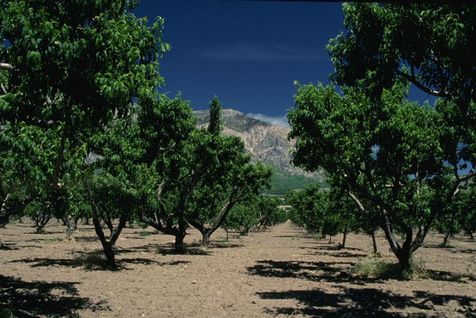
Peach Orchard

Slide 9
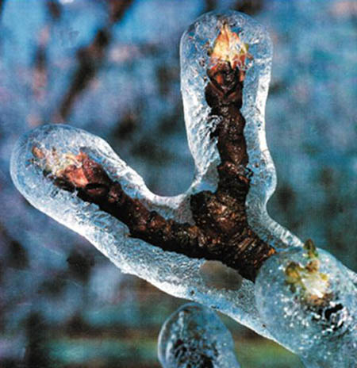
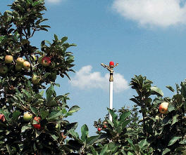
Frost Protection w/Irrigation

Slide 10
Fruit Tree Propagation
Rootstocks are field-grown from cutting
  100+ for fruit trees – 20 for apples
  Dwarfing characteristics (semi-dwarf)
  Graft compatibility
  Disease resistance
  Early fruit production (precocity)
Interstem material is sometimes used
Scion – known variety that is budded on to the rootstock or interstem

Slide 11
Dwarfing Effects of Various Apple Rootstocks

Slide 12
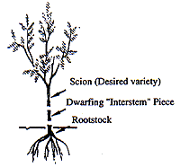
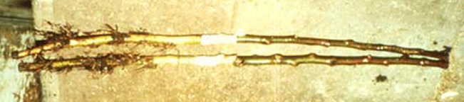
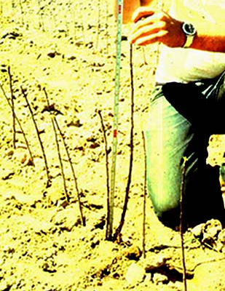
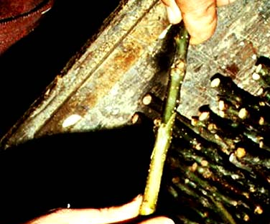
Grafting/Budding
After wax has been applied
Bench Grafting M111 to M9 Interstem
Planted in the field

Slide 13
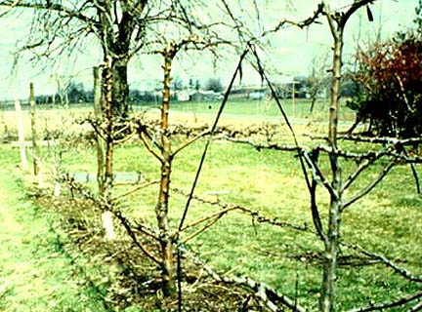
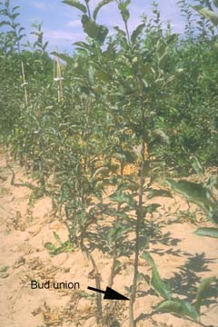
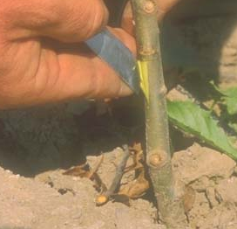
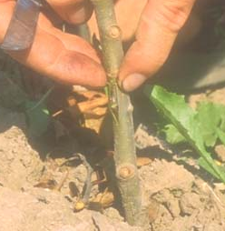
Grafting/Budding (cont.)
Bud wood grown to produce scions
T-budding mid to late summer
5 foot tall tree the following season

Slide 14
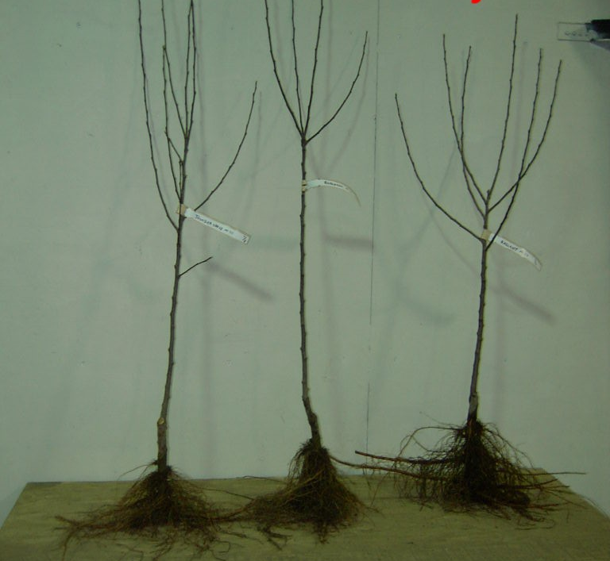
Tree Selection
Bare root
Container
Box
Ball and Burlap
Look for young, well-labeled trees with healthy roots and stems. Beware of bargains. The price of the tree will be the smallest expense in the long-run.

Slide 15
Variety Selection
Know your climate
  Sunset, USDA Plant Hardiness, U of A
Chilling Requirement
  Accumulation of hours below 45ºF and above 32ºF
  Each fruit variety has a corresponding chilling requirement
Self fruitful vs. non-self fruitful (requiring cross pollination)
Select varieties that bear at different times

Slide 16
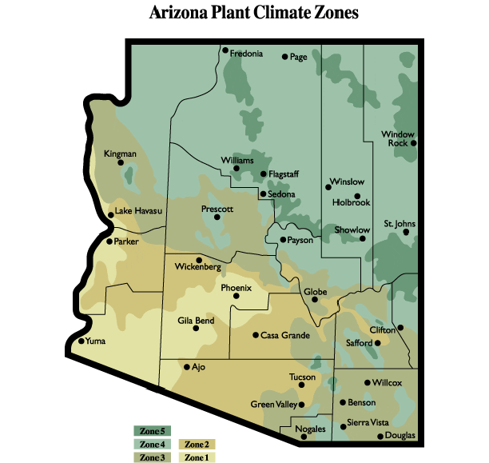
Arizona’s Climate Zones

Slide 17
Chilling Requirements for Yavapai County
Verde Valley (3,000 to 4,500 ft)
  600 to 750 chill hours
Prescott (4,500 to 6,000 ft)
  750 to 1,000 chill hours
These numbers are approximate and some fruit varieties do not have chilling requirements high enough for our area

Slide 18
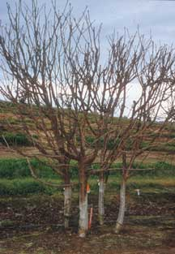
Tree Spacing
Semi-dwarf apples, peaches, apricots, and plums should be about 15-18 ft apart
High-density planting
Multi-budded “cocktail” trees

Slide 19
Planting
Prune out damaged roots with clean, sharp tools
Plant trees in native, non-amended soil during the month of March
Soak the bare root tree roots in a bucket of water before planting
Add soil and water incrementally to prevent air pockets
Plant at same depth as it was grown in the nursery – bud union should 2-3 inches above the soil line
Some people recommend the graft union face north

Slide 20
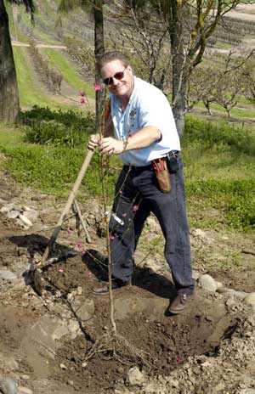
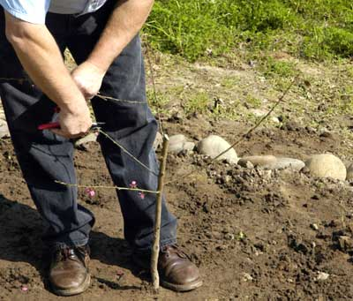
Planting and Initial Pruning

Slide 21
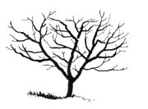
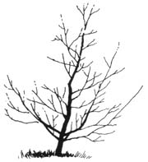
Pruning
Modified Central Leader
  Apples and pears
Open Center
  Stone fruits: peaches, nectarines, plums, apricots, cherries, etc. Some people prunes apples and pears this way too

Slide 22
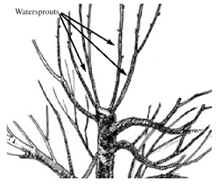
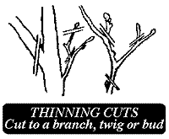
Pruning
Heading Cut
Thinning Cut

Slide 23
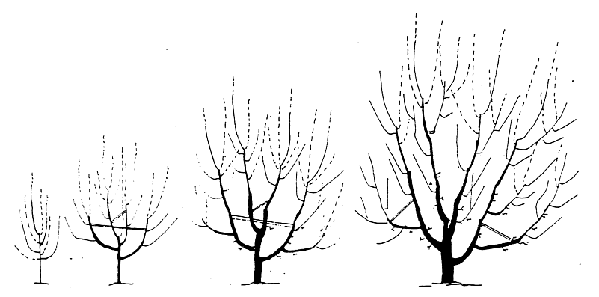
Open Center Pruning

Slide 24
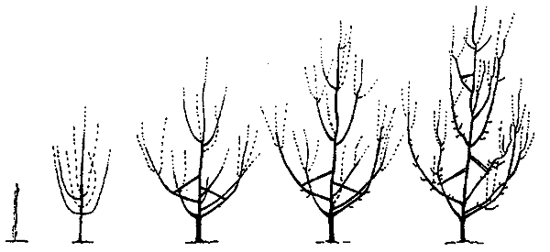
Modified Central Leader

Slide 25
Irrigation
Flood/basin irrigation is probably best, basin should be 2 feet beyond drip line
Drip irrigation is also effective as long as it adequately designed and function
Microsprinklers will also do the job
Apply some water during dry winter periods
Mulching will prevent evaporation, but can also prevent the soil from warming

Slide 26
Fertilization
Nitrogen is the primary concern (P and K are probably adequate)
Pears-0.05 lb N/inch of trunk diameter and up to 0.5 lb N/tree
Apples and Stone Fruits-0.1 lb N/inch of trunk diameter and up to 1.0 lb N/tree

Slide 27
Fertilizer Calculations
Apple with a 7 inch trunk diameter
7 inches x 0.1 lb N/inch dia.=0.7 lbs N
Using ammonium sulfate (21-0-0)
0.7 lbs N x 100 lb fert/21 lb N= 3.3 lb ammonium sulfate/tree
It is best to split the application between April and July/August
1.7 lb at each time

Slide 28
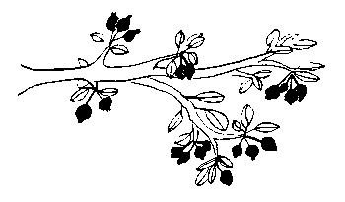
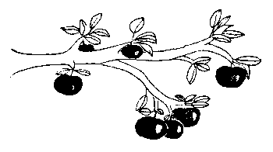
Thinning Fruit
Thinning improves fruit quality and can increase yields
Thin fruit to be about 5 to 8 inches apart and only one fruit per cluster

Slide 29
Harvesting Fruit
Apples
  When normal, unblemished fruit begin to drop
  Flesh color at the bottom of the fruit has changed from green to yellow-green
  Taste it (the birds will also eat it)
Apricots
  Softens slightly and easily separates from the stem

Slide 30
Harvesting Fruit (cont.)
Cherry
  Maximum sized and full-flavored
  Will not ripen off the tree
  Sweet cherries remain firm when ripe
  Sour cherries pull off stem easily
Peaches/Nectarines
  Fruit separates easily from the stems
  Will ripen best on the tree

Slide 31
Harvesting Fruit (cont.)
Pear
  Should be picked slightly before ripe and will ripen further indoors
  Change in fruit color from green to yellow
Plums
  Sugar increases and color changes
  Flesh softens somewhat

Slide 32
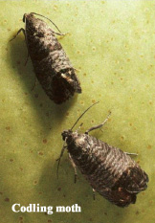
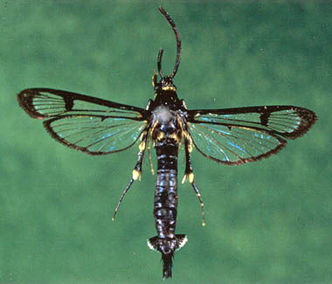
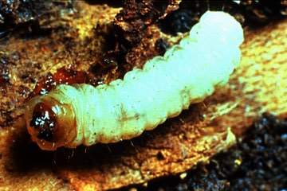
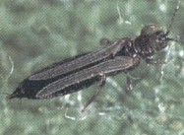
Fruit Tree IPM-Insects
Codling Moth
Peach Tree Borer
Aphids
Thrips
Stink Bugs/Plant Bugs
Wooly Apple Aphid

Slide 33
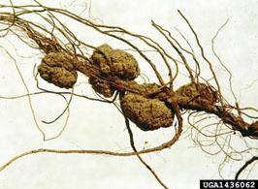
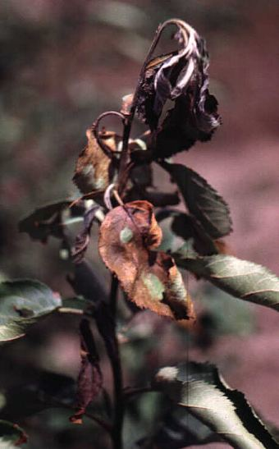
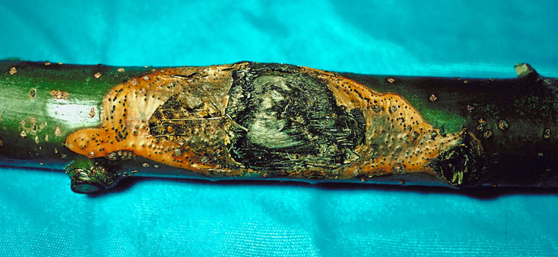
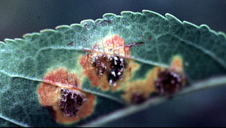
Fruit Tree IPM-Diseases
Crown Gall
Fire Blight
Texas Root Rot
Cytospora Canker
Cedar Apple Rust

Slide 34
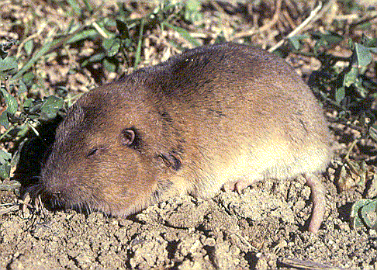
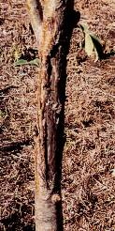
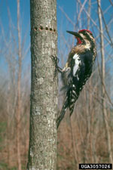
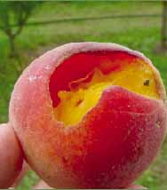
Fruit Tree IPM-Vertebrates
Pocket Gophers
Deer/Elk
Sapsuckers/Woodpeckers
Birds

Slide 35
Final Thoughts
Choose appropriate varieties
Grow what you enjoy
When the trees get old, replace them
Keep good records (flavor, productivity, years of crops, etc.)
Have Fun!

