Slide 1


Backyard
Composting
Granville Garden Club
7/11/2018

Slide 2
Compost vs Mulch
Compost is full of nutrients that we want to get down in the soil to feed the plants through their roots.
Mulch is the layer of organic materials placed on the top of the soil as a protective cover.

Slide 3
Why Compost?
Recycle waste materials
Enhance soil structure
Reduce soil losses from erosion
Improve oxygen availability in soil
Increase organic matter
Increase essential plant nutrients
Increase biological activity
Conserve water

Slide 4
What Makes Compost?
Raw materials (chemical composition)
Organisms present
Moist, oxygen-rich environment
A dedicated space
An observant, yet patient gardener

Slide 5
Raw Materials
Kitchen waste
Yard Waste
Shredded paper/newspapers
Floor sweepings
Vacuum cleaner contents
Wood ashes (some, not a lot)
Shredded green yard waste
Animal manure
Spoiled hay
Be creative – watch for materials

Slide 6


Materials NOT to Compost
Meat/Fat Scraps
Grease/Oil
Pet Waste (parasites may be present)
Large Woody Material
Diseased Plants
Weeds Gone to Seed
Toxic Materials (paint chips, etc.)

Slide 7
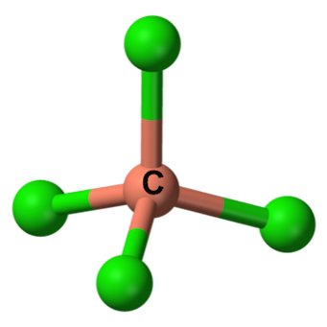
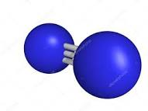
The Basics-Just Science
It’s all about
CARBON
and
NITROGEN

Slide 8

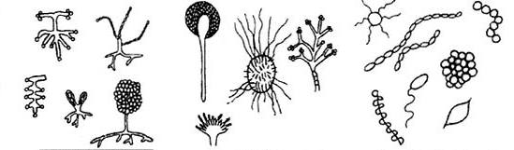






The Basics-It’s Gross!
Micro and Macro Organisms
EAT
Carbon and Nitrogen
in Decaying Materials

Slide 9
Factors that Impact the Process
Materials – the “Food”
Air – Oxygen needed for organisms
Moisture – Water dissolves organic molecules
Temperature – Determines speed of process
Particle size – Affects rate of breakdown
Volume – Determines heat retention

Slide 10
Impact of Low & High C:N Ration
Composting materials with a very low C:N ratio of 7:1 would rot very quickly, because they are high in nitrogen, eg. fish, this decomposes very quickly
Composting materials with a very high C:N ratio of 500:1 would take a long time to decompose, because they are low in nitrogen, and need to be broken up, eg. tree branches

Slide 11
C:N Ratios of Some Materials
Food wastes | 15:1
Sawdust, wood, paper | 400:1
Straw | 80:1
Grass clippings | 15:1
Leaves | 50:1
Fruit wastes | 35:1
Rotted manures | 20:1
Cornstalks | 60:1
Alfalfa hay | 12:1

Slide 12
Take Your Pick
HOT
or
COLD

Slide 13
Comparing Hot & Cold Composting
Cold Composting
Fast
High Maintenance
Pile can catch on fire
Heat can kill bacteria that suppress soil borne diseases
Hot Composting
Slow
Low maintenance
Can be added to over time
Vulnerable to weeds
Can become smelly

Slide 14
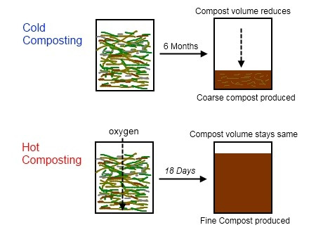
Comparing Cold & Hot Composting

Slide 15
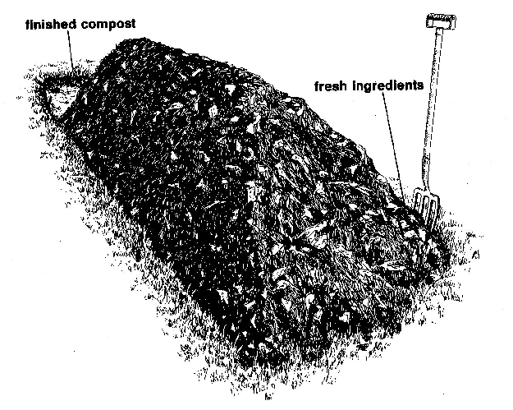
Methods: Wandering Pile

Slide 16
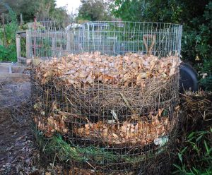
Methods: Add-As-You-Go

Slide 17
Methods: University of CA
Berkley Method (Quick-Hot)
Build compost heap
4days – no turning
Then turn every 2nd day for 14 days

Slide 18
GENERAL STEPS

Slide 19
Initial Pile Construction
1st layer: 3-4" of chopped brush or other coarse material (air circulation
2nd layer: 6-8" of mixed scraps, leaves, grass clippings, etc.
3rd layer: 1"of soil serves as an microbial inoculant
4th layer: (optional) 2-3" of manure to provide the nitrogen needed by microorganisms
Repeat until desired height/volume

Slide 20
Compost Temperature
Well constructed piles will reach 140 degrees F in four or five days
Decomposition will occur between 50 and 105 degree F (cool compost)
Temperatures ranging 110 to 150 degrees F will kill many pathogens and weed seeds (hot compost)
Spontaneous combustion can occur at higher temperatures – be careful

Slide 21
Compost Moisture
Too much limits oxygen and can leach nutrients from the pile
Too little prevents microbial activity
Ideally, the materials are as moist as a wrung out sponge

Slide 22
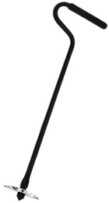

Compost Aeration and Turning
Piles can be turned after 3-4 weeks
Periodic turning will result in faster composting
Piles that have stopped working may need additional nitrogen (manure)
Turning tools are available

Slide 23
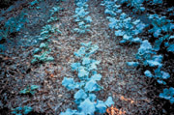
Compost Application
If limited, use compost as a soil amendment
If abundant, use compost as a top dressing or mulch

Slide 24
Tips (again) on Heating up the Mix
Make sure you have enough “green”. Ratio should be 4 brown to 1 green
Is the pile wet enough? Should feel like a damp sponge when squeezed
A cool pile may mean low bacteria. Toss on a handful of dirt
When did you last turn it? Aeriation is critical!
Use a compost “helper” or accelerator

Slide 25
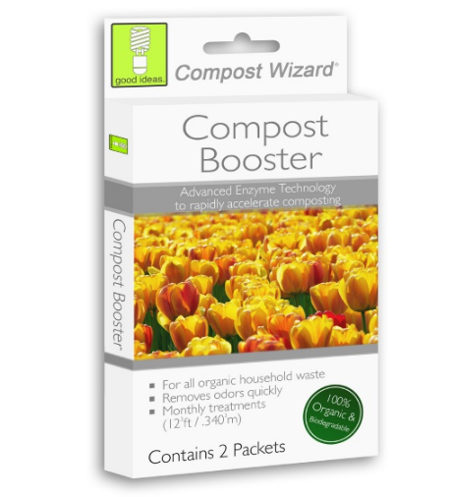
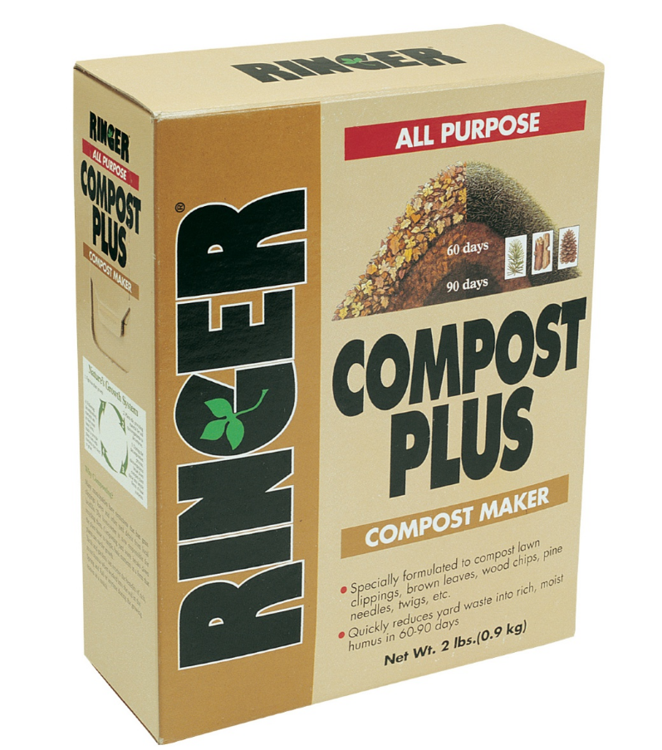
Compost Helpers

Slide 26
Compost Helpers
Recipe 1:
In a 5 gallon bucket put:
2 shovelfuls of good garden soil
one packet of dry
1/4 cup of molasses
Add warm water to fill the bucket within 3 inches of the top and stir. Place the bucket in the sun and stir every few hours for 24 to 48 hours. Once the accelerator is brewed, pour the mixture over the compost pile.

Slide 27
Compost Helpers
Recipe 2:
In a 5 gallon bucket put:
1 gallon of warm water
1 can of flat, warm beer
1can of cola
Mix in ½ cup of household ammonia
Stir well, until all of the ingredients are thoroughly blended and then pour the solution slowly over the compost heap.

Slide 28
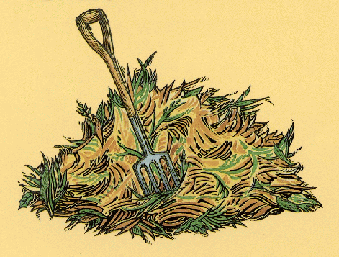
Composting Tools
Essential
  Spading or Pitch Fork
  Water Source
Optional
  Thermometer
  Bin(s)
  Chipper
  Turning Tool

Slide 29
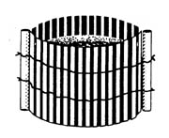
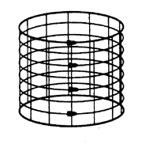
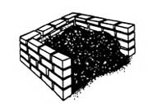
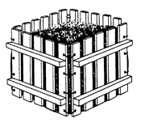
Containers: Homemade Bins

Slide 30
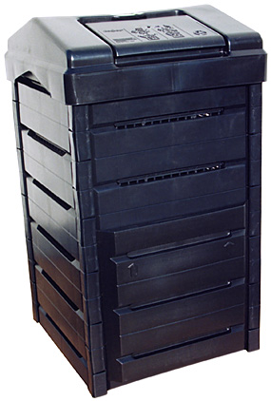
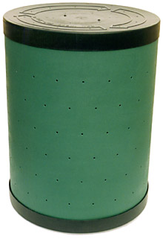
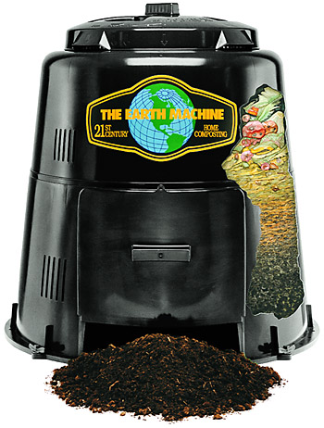
Containers : Prefab Bins

Slide 31
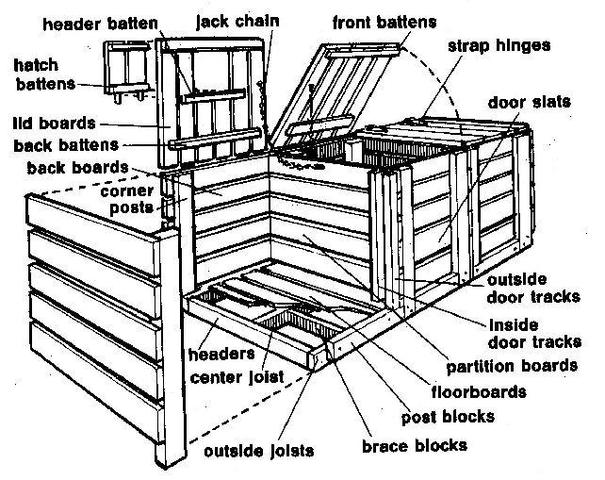
Containers : Three Bins

Slide 32
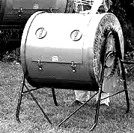
Containers : Rotating Drum

Slide 33
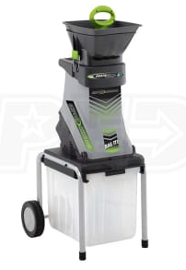
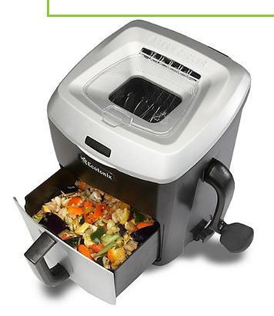
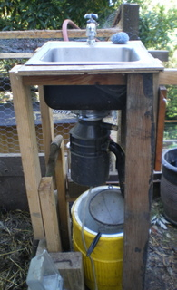
Chippers and Shredders
Electronic Hand crank Home made

Slide 34
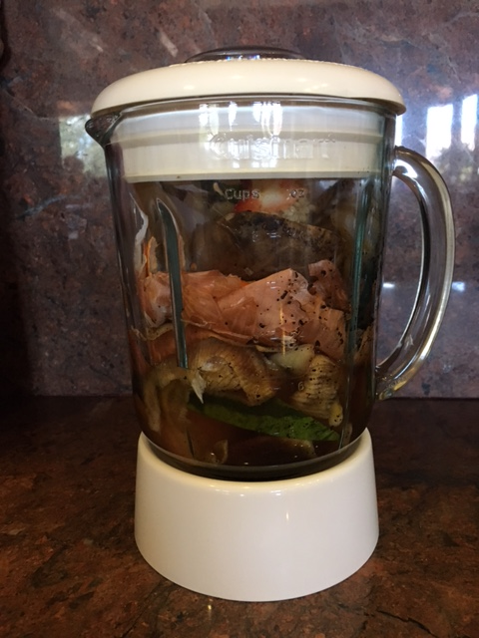

Slide 35
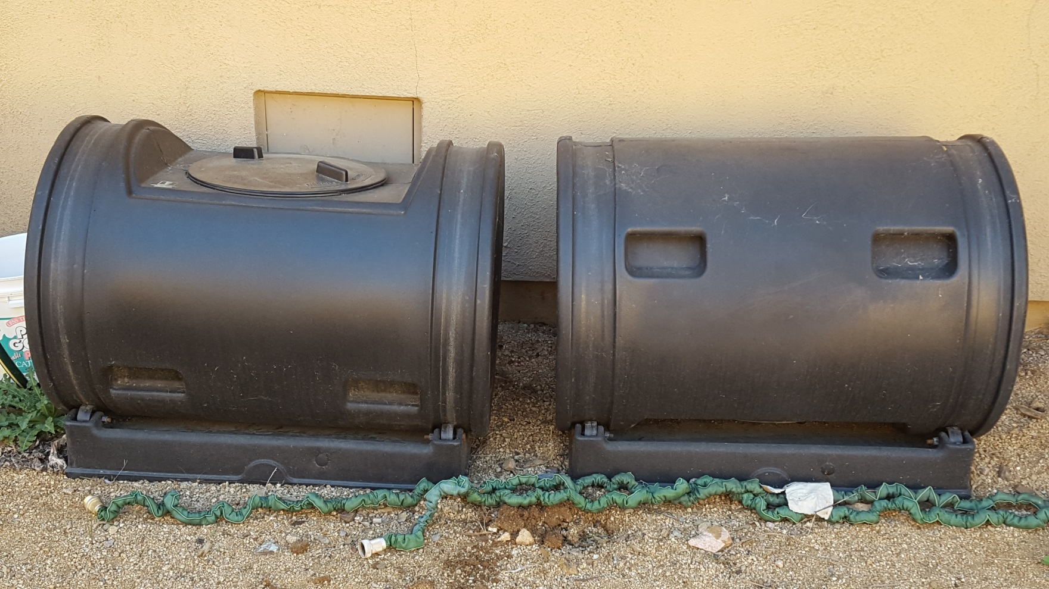
My composters

Slide 36
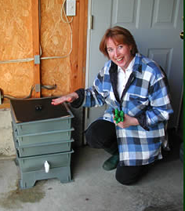
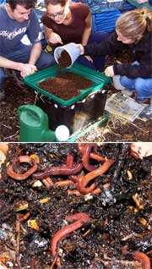
Vermicomposting
Manure worms, red wigglers, or brandlings are used
Need a protected environment and regular monitoring
Covered bins limit odors and unwanted insects
Material should be ground up or blended before feeding
Worm castings are super-charged compost

Slide 37
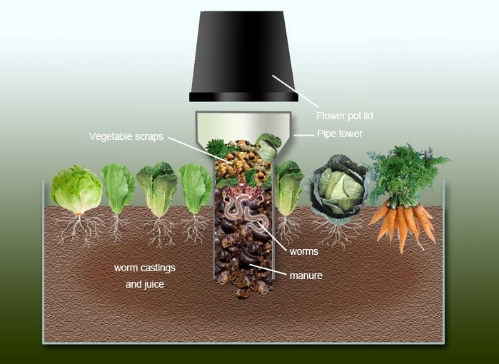

Slide 38
Final Thoughts on Composting
Use method that fits your style
Don’t make it too complicated
Vegetable gardens can rarely have too much organic matter
There are few valid excuses for not composting

